Slide 1
Understanding Intentions through Human teaching motions
B4 komota Tetsuya

Slide 2
Background
It is expected to realize a general-purpose robot which are able to do task in the human living environment.
General-purpose robots need the ability to learn the behavior from the interaction with humans.
→It is NOT just “imitation”.
The ability to learn the human intentions from the human motions is necessary.
It enables robots to predict the task goal.

Slide 3




Background
Ex) The task “Take the cup.”
Teaching the task
Just imitation
Take the cup.
Take the cup.

Slide 4
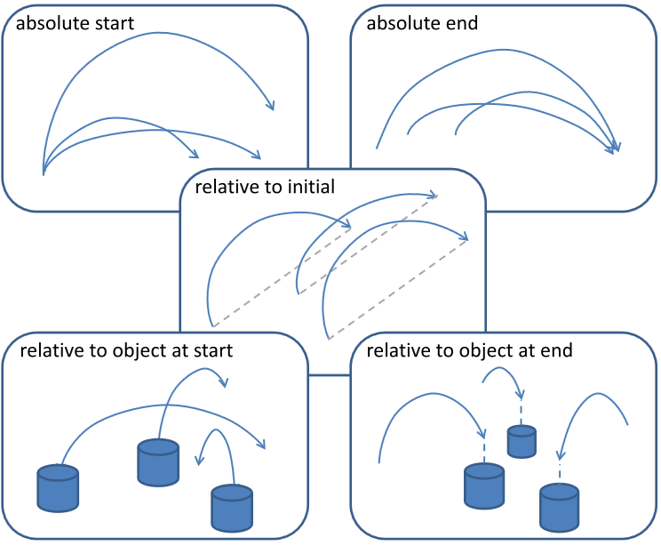
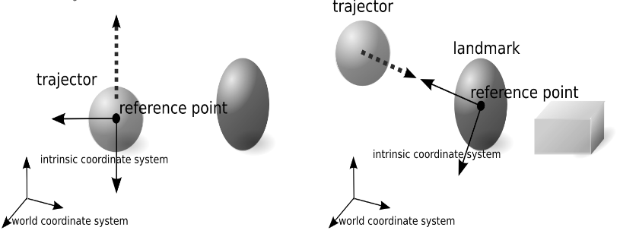
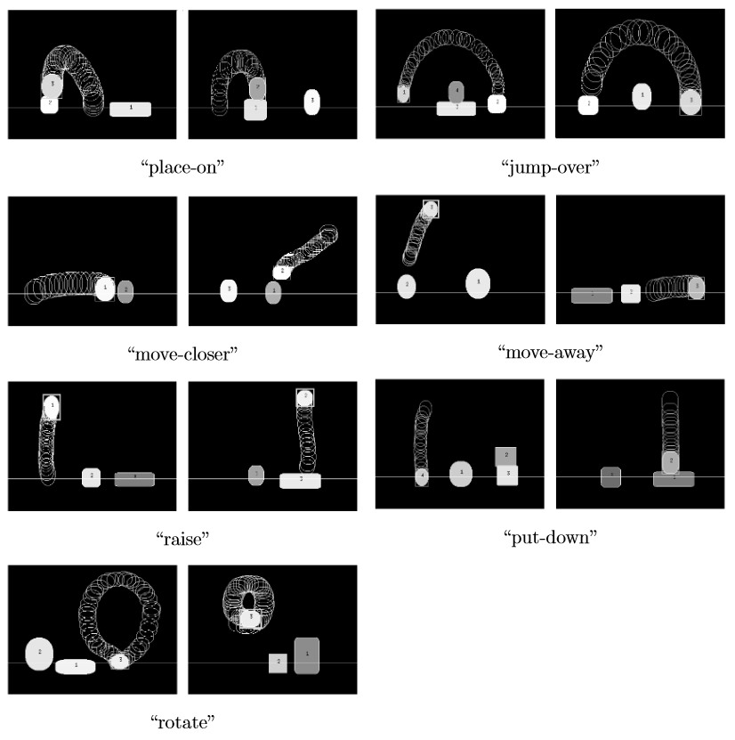
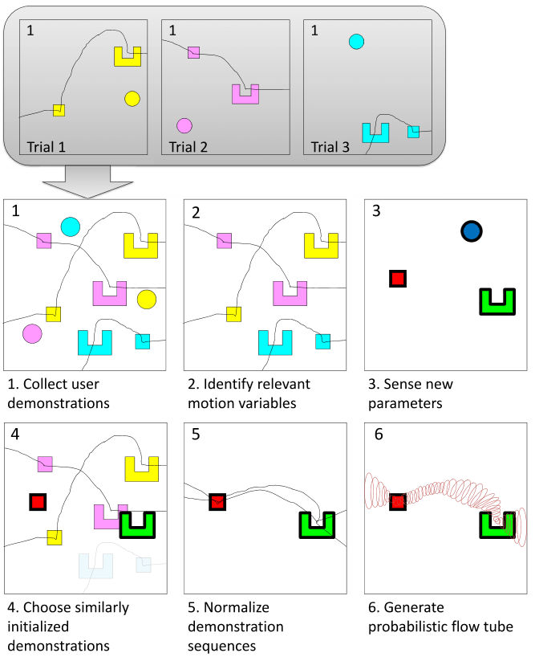
Related Works
[Sugiura 2011]
[Dong 2012]

Slide 5
Proposed Method
Word Definition
Task : The pair of start positions and goal positions of the all objects.
Viewpoints : The human intention, which influence to decide a goal of trajector.
Reference points : the origin to decide the viewpoints.
(ex. Position of objects , center of environment)
Viewpoint = Reference point + Displacement

Slide 6
Reference Point
The tasks (deciding the goal point) include the following types.
1.Constant displacement.
2.Constant position.
3. according to the position of the other objects.
If the point of center and the start of trajector are included to the reference points , the 1. and 2. tasks can be included to the 3. tasks.

Slide 7

Reference Point
The tasks (deciding the goal point)
include the following types.
1.Constant displacement.
2.Constant position.
3. according to the position of
other objects.

Slide 8
Displacement
The displacements include the following types.
1.Constant direction.
2.According to the position of the trajector and reference points.
3.According to the position of the reference point and the objects.
in order to distinguish these, it is necessary to consider the several coordinate system.

Slide 9
Displacement
The displacements include the
following types.
1.Constant direction.
2.According to the position of the
trajector and reference points.
3.According to the position of the
reference point and the objects.
Right of the blue.
Near of the blue.
Line up clockwise.

Slide 10
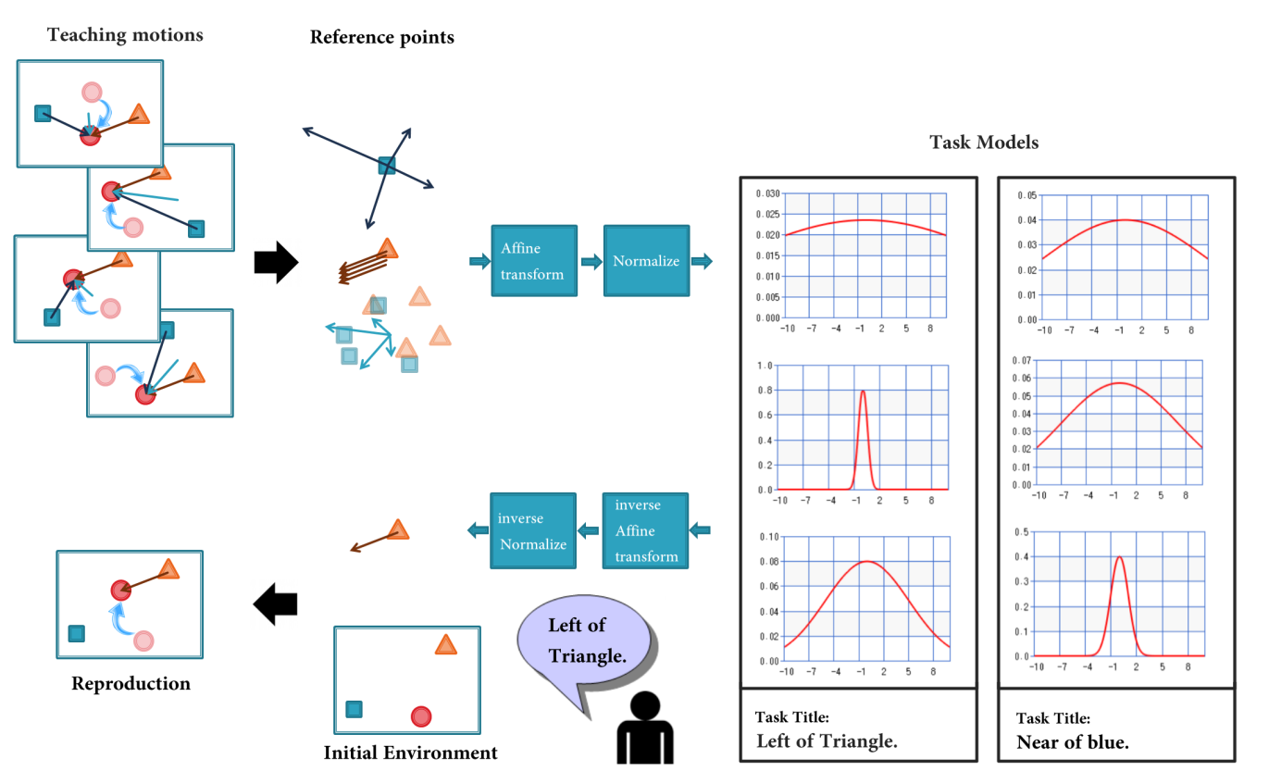
Model

Slide 11
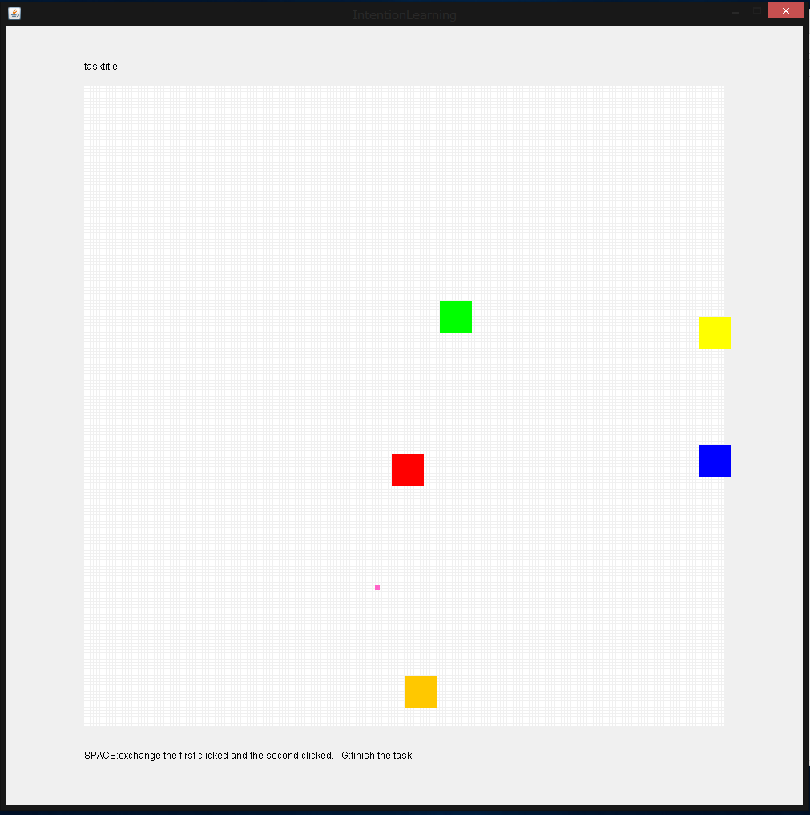
Experiments
Environments
Serial-2D map.
There are a trajectory
and 4 objects.
For the computer,
Known:
Map range, the number of objects,
These positions, the kind of viewpoints
Unknown:
The true viewpoint for the task.

Slide 12
Experiments
The tasks learned by the computer are the following.
1.Move the red to the center.
2.Move the red to right of the blue.
3.Move the red to the near of the orange.
4.Move the red away from the green.
5.Move the red to line up the red ,yellow and blue equidistantly.
6. Move the red to line up the red , green and blue clockwise.
Success : Appropriate viewpoints was chosen.

Slide 13
Results

Slide 14

Identification Experiments
He did
“Take the cup.”

Slide 15
Identification Experiments
The tasks learned by the computer are the following.
1.Move the red to the center.
2.Move the red to right of (each object).
3.Move the red to the near of (each object).
4.Move the red away from (each object).
5.Move the red to line up the red ,yellow and blue equidistantly.
6. Move the red to line up the red , green and blue clockwise.
The computer answers the best likely Task.
Success : Appropriate task was chosen.

Slide 16
Results
Task name | Count of error | Success rate
Move the red to the center. | 4 | 0.96
Move the red to the right of the blue. | 2 | 0.98
Move the red to the near of the orange. | 3 | 0.97
Move the red away from the green. | 3 | 0.97
Move to line up equidistantly. | 0 | 1
Move to line up clockwise. | 4 | 0.96

Slide 17
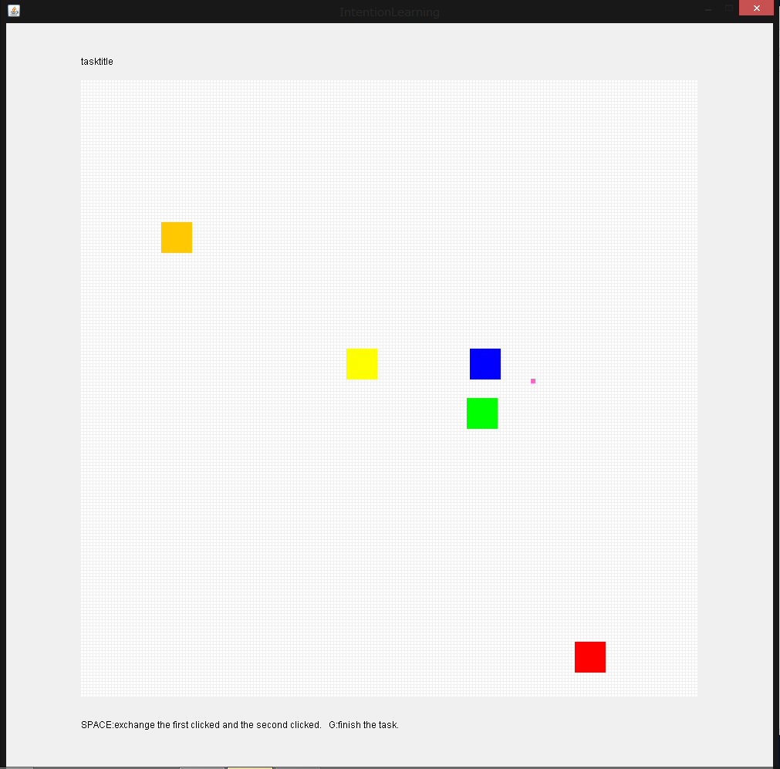
Results
The examples of false identification.
True : away from the green
Answer : near of the orange
True : right of the blue
Answer : line up clockwise

Slide 18
Conclusion
I aimed to understand the human intention from the human motion and to reproduce the task in consideration of the human intention.
The proposed method enable to recognize the motion in consideration of the positions of multi objects.

Slide 19
Future works
More Highly
1. Learning the sequence of the task primitives.
2. Limitation the range to attention.
3. Test other learning models.
More General
1. Using general features to recognize intention.
2. Learning the multi-goal tasks.
More Useful
1. Neglect the false teaching motion.
2. Combination of NLP.

Slide 20
References
[1]中岡慎一郎, et al. "シンボリックな動作記述を用いた舞踊動作模倣ロボットの実現." 電子情報通信学会技術研究報告. PRMU パターン認識・メディア理解 103.390 (2003): 55-60.
[2]Schaal, Stefan. "Dynamic movement primitives-a framework for motor control in humans and humanoid robotics." Adaptive Motion of Animals and Machines. Springer Tokyo, 2006. 261-280.
[3]杉浦孔明, et al. "Learning, generation and recognition of motions by reference-point-dependent probabilistic models." Advanced Robotics 25.6-7 (2011): 825-848.
[4]Dong, Shuonan, and Brian Williams. "Learning and recognition of hybrid manipulation motions in variable environments using probabilistic flow tubes." International Journal of Social Robotics 4.4 (2012): 357-368.

Slide 21
Results
The unit = length of the object/10
Teaching error = the variance of the teaching motion.
Reproduction error = the standard deviation of the reproduced motion.

Slide 22
Results
The unit = length of the object/10
Teaching error = the variance of the teaching motion.
Reproduction error = the standard deviation of the reproduced motion.

Slide 23
Results
The unit = length of the object/10
Teaching error = the variance of the teaching motion.
Reproduction error = the standard deviation of the reproduced motion.

Slide 24


Slide 25
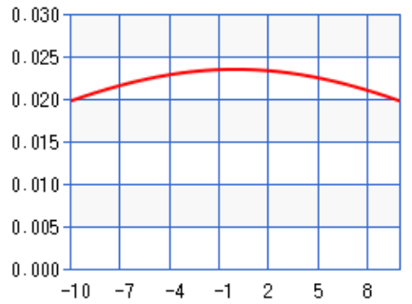
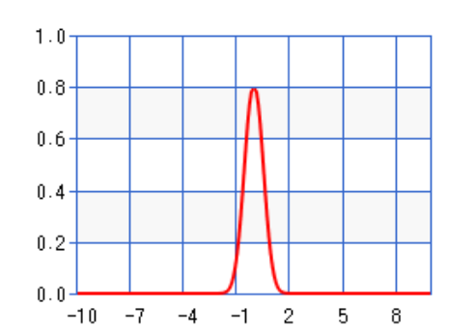
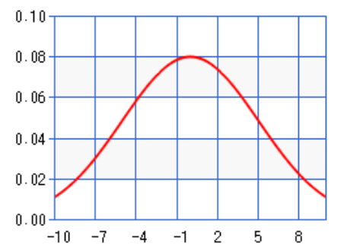
Affine
transform
Normalize

